Slide 1
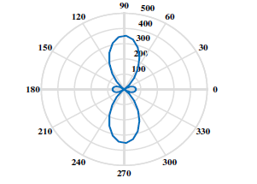
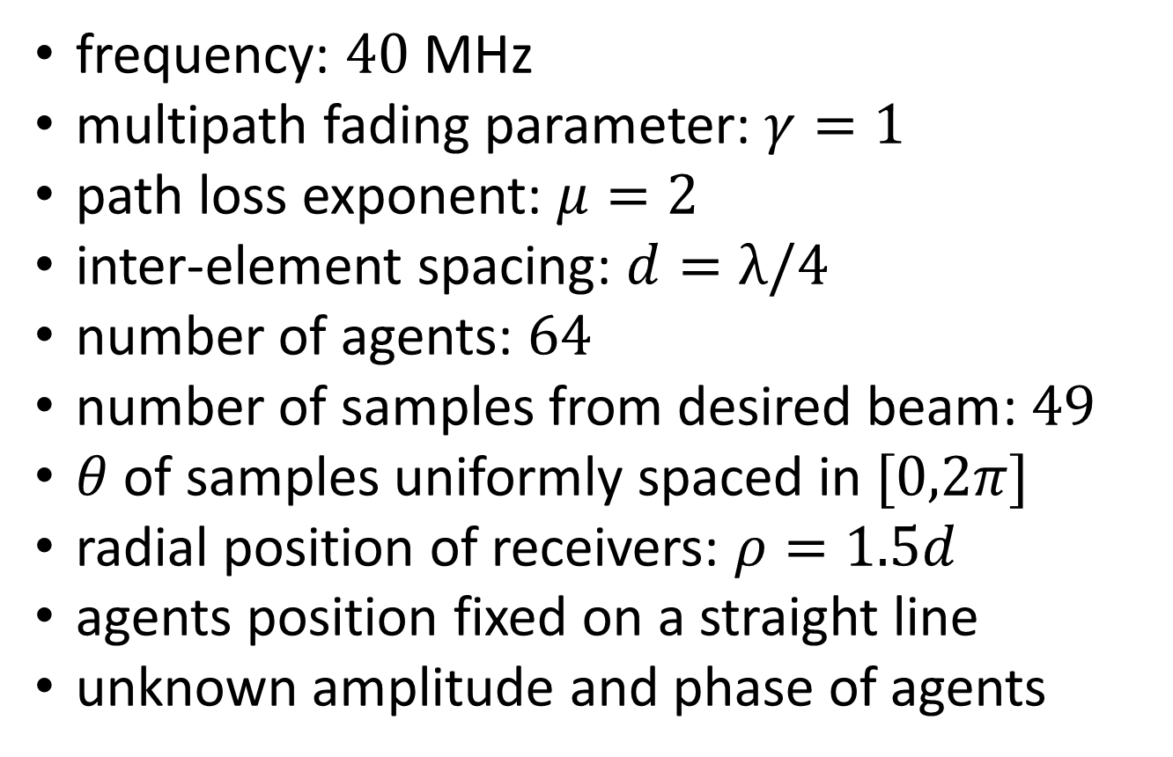
Problem Settings
frequency: $40$ MHz
multipath fading parameter: $γ=1$
path loss exponent: $μ=2$
inter-element spacing: $d=λ/4$
number of agents: $64$
number of samples from desired beam: $49$
$θ$ of samples uniformly spaced in $[0,2π]$
radial position of receivers: $ρ=1.5d$
agents position fixed on a straight line
unknown amplitude and phase of agents

Slide 2
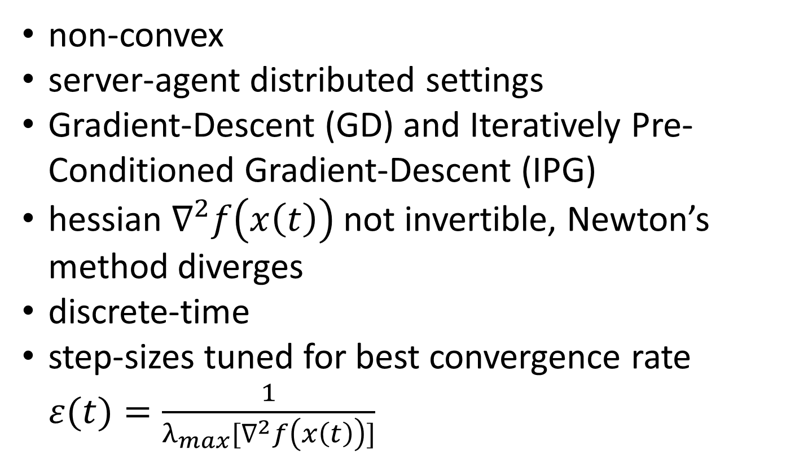
Experiments
non-convex
server-agent distributed settings
Gradient-Descent (GD) and Iteratively Pre-Conditioned Gradient-Descent (IPG)
hessian $∇^{2}f\left(x\left(t\right)\right)$ not invertible, Newton’s method diverges
discrete-time
step-sizes tuned for best convergence rate $ε(t)=\frac{1}{λ_{max}[∇^{2}f\left(x\left(t\right)\right)]}$

Slide 3
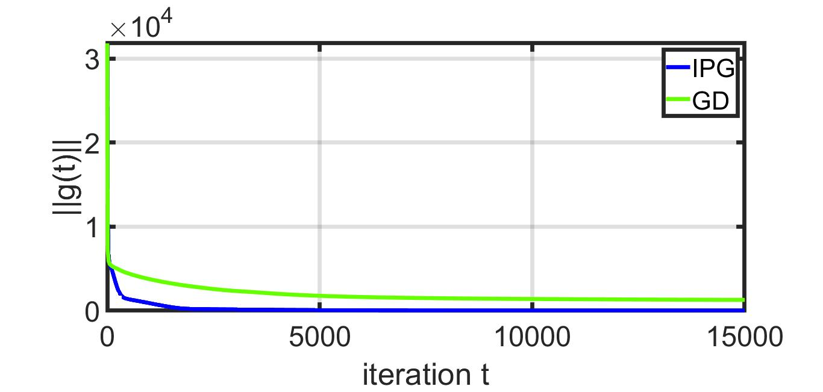
Simulation Results

